Slide 1
Vapor Liquid Equilibrium (VLE) Final Presentation
Group Name: Just Diene (Group 6)
Instructor: Dr. Douglas J. Buttrey
Date: April 3rd, 2021
Group Members:
Daniel Robinson Abdul Fayeed Neel Shah Evan Sciacchitano

Slide 2
OVERVIEW
Objectives
Background
Safety Review
Procedure
Data Analysis
Conclusion & Recommendations
Supplemental Information

Slide 3
OBJECTIVES
The objective of this experiment is to determine the isobaric vapor-liquid equilibrium (VLE) of the acetone-methanol-ethanol ternary system mixture by analyzing the three binary mixtures separately; acetone-methanol (AM), methanol-ethanol (ME), and acetone-ethanol (AE). From the binary analyses, the ternary behavior of the system can be predicted. The information can then be used to assess the prospects for separation of the components.

Slide 4
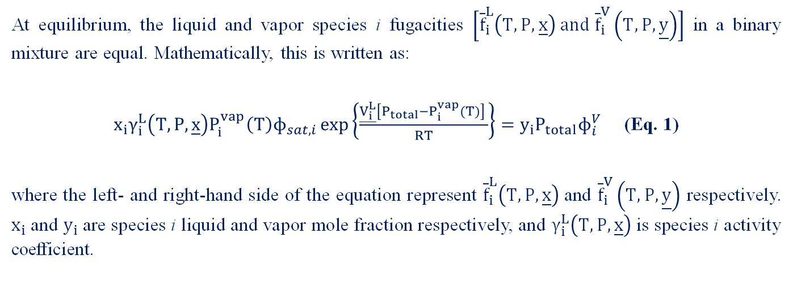
BACKGROUND
At equilibrium, the liquid and vapor species i fugacities $\left[{\overline{f}}_{i}^{L}\left(T,P,\underline{x}\right) and {\overline{f}}_{i}^{V}\left(T,P,\underline{y}\right)\right]$ in a binary mixture are equal. Mathematically, this is written as:
$x_{i}γ_{i}^{L}\left(T,P,\underline{x}\right)P_{i}^{vap}\left(T\right)ɸ_{sat,i}\exp\left\{\frac{\underline{V_{i}^{L}}\left[P_{total}−P_{i}^{vap}(T)\right] }{RT}\right\}=y_{i}P_{total}ɸ_{i}^{V}$ (Eq. 1)
where the left- and right-hand side of the equation represent ${\overline{f}}_{i}^{L}\left(T,P,\underline{x}\right)$and ${\overline{f}}_{i}^{V}\left(T,P,\underline{y}\right)$ respectively. $x_{i}$ and $y_{i}$ are species i liquid and vapor mole fraction respectively, and $γ_{i}^{L}\left(T,P,\underline{x}\right)$ is species i activity coefficient.

Slide 5
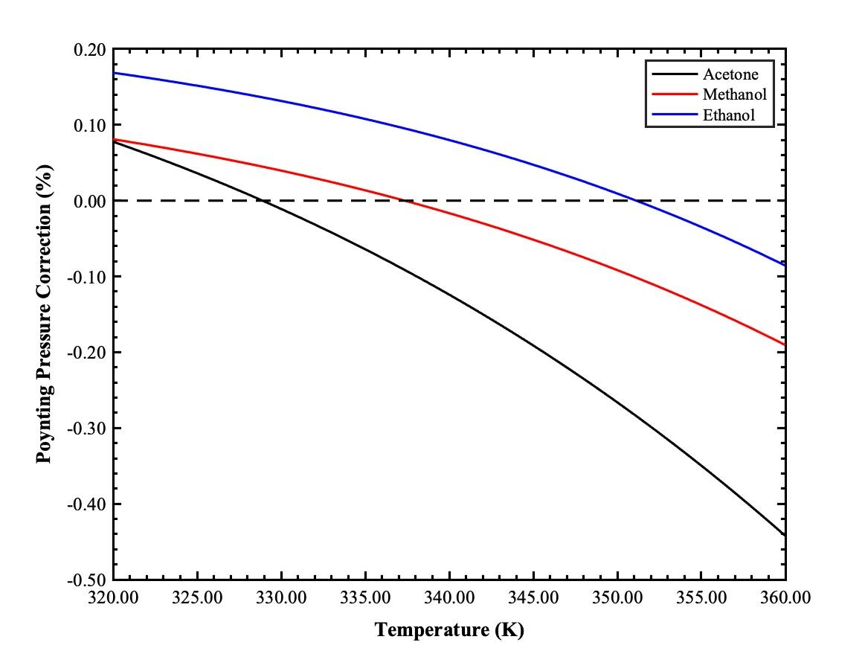
Poynting Pressure Correction
$\exp\left\{\frac{\underline{V_{i}^{L}}\left[P_{total}−P_{i}^{vap}(T)\right] }{RT}\right\}$
Compound | Poynting Correction (%) | Temperature Range (K)
Acetone | 0.00 - 0.44 | 320 - 360
Methanol | 0.00 - 0.19
Ethanol | 0.00 - 0.17

Slide 6
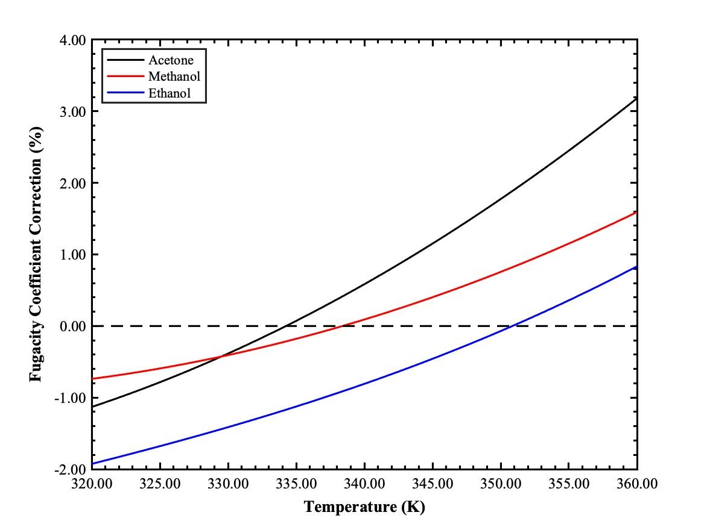
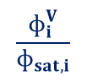
Fugacity Coefficient Correction using PR-EOS
$$\frac{ɸ_{i}^{V}}{ɸ_{sat,i}}$$
Compound | Fugacity Coefficient Correction (%) | Temperature Range (K)
Acetone | 0.00 – 3.20 | 320 - 360
Methanol | 0.00 – 1.60
Ethanol | 0.00 – 2.00

Slide 7
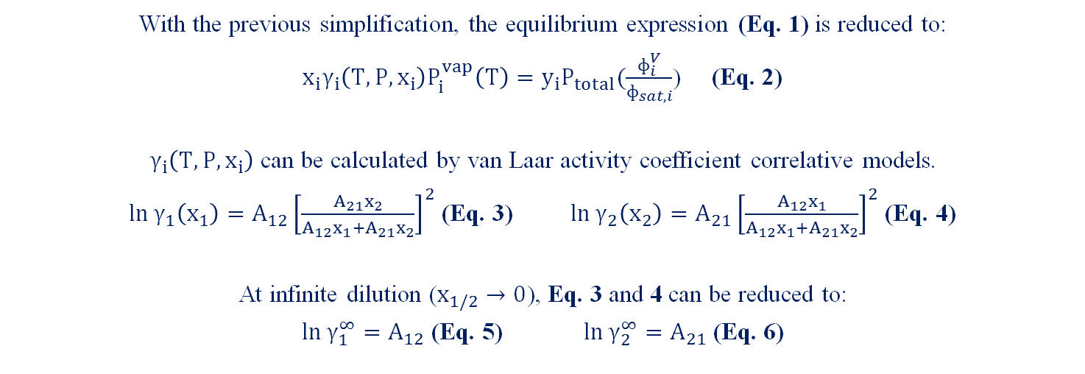
EQUILIBRIUM & ACTIVITY COEFFICIENT
With the previous simplification, the equilibrium expression (Eq. 1) is reduced to:
$x_{i}γ_{i}\left(T,P,x_{i}\right)P_{i}^{vap}\left(T\right)=y_{i}P_{total}(\frac{ɸ_{i}^{V}}{ɸ_{sat,i}}$) (Eq. 2)
$γ_{i}\left(T,P,x_{i}\right)$ can be calculated by van Laar activity coefficient correlative models.
$\ln{γ_{1}\left(x_{1}\right)=A_{12}{\left[\frac{A_{21}x_{2}}{A_{12}x_{1}+A_{21}x_{2}}\right]}^{2}}$ (Eq. 3) $\ln{γ_{2}\left(x_{2}\right)=A_{21}{\left[\frac{A_{12}x_{1}}{A_{12}x_{1}+A_{21}x_{2}}\right]}^{2}}$ (Eq. 4)
At infinite dilution ($x_{1/2}→0$), Eq. 3 and 4 can be reduced to:
$\ln{γ_{1}^{∞}=A_{12}}$ (Eq. 5) $\ln{γ_{2}^{∞}=A_{21}}$ (Eq. 6)

Slide 8
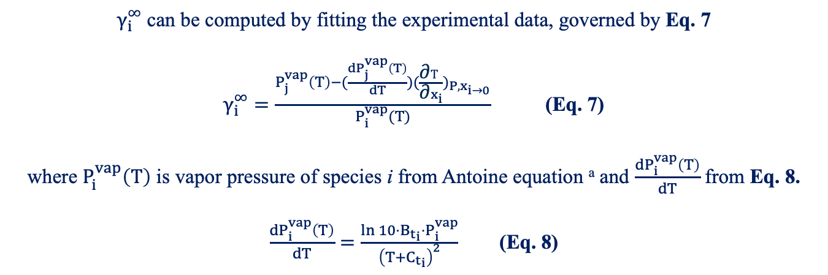
Infinite Dilution
$γ_{i}^{∞}$ can be computed by fitting the experimental data, governed by Eq. 7
$γ_{i}^{∞}=\frac{P_{j}^{vap}\left(T\right)−(\frac{dP_{j}^{vap}\left(T\right)}{dT})(\frac{\text{∂}T}{\text{∂}x_{i}})_{P,x_{i→0}}}{P_{i}^{vap}(T)}$ (Eq. 7)
where $P_{i}^{vap}\left(T\right)$ is vapor pressure of species i from Antoine equation ª and $\frac{dP_{i}^{vap}\left(T\right)}{dT}$ from Eq. 8.
$\frac{dP_{i}^{vap}\left(T\right)}{dT}=\frac{{\ln{10}⋅{B_{t}}_{i}⋅P}_{i}^{vap}}{{\left(T+{C_{t}}_{i}\right)}^{2}}$ (Eq. 8)
ª See Supplemental A for Antoine parameters

Slide 9
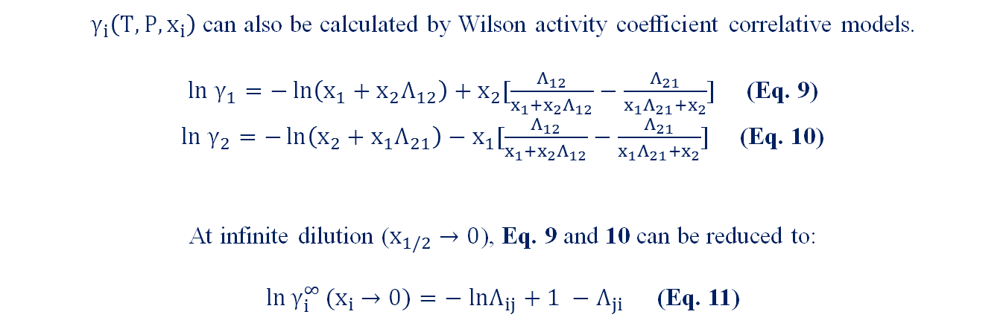
Wilson Model Correlative model
$γ_{i}\left(T,P,x_{i}\right)$ can also be calculated by Wilson activity coefficient correlative models.
$ln{ γ}_{1}=−\ln\left(x_{1}+x_{2}Λ_{12}\right)+x_{2}[\frac{Λ_{12}}{x_{1}+x_{2}Λ_{12}}−\frac{Λ_{21}}{x_{1}Λ_{21}+x_{2}}]$ (Eq. 9)
$ln{ γ}_{2}=−\ln\left(x_{2}+x_{1}Λ_{21}\right)−x_{1}[\frac{Λ_{12}}{x_{1}+x_{2}Λ_{12}}−\frac{Λ_{21}}{x_{1}Λ_{21}+x_{2}}]$ (Eq. 10)
At infinite dilution ($x_{1/2}→0$), Eq. 9 and 10 can be reduced to:
$\ln{γ_{i}^{∞}}(x_{i}$ $→0)=− lnΛ_{ij}+1 −Λ_{ji}$ (Eq. 11)

Slide 10
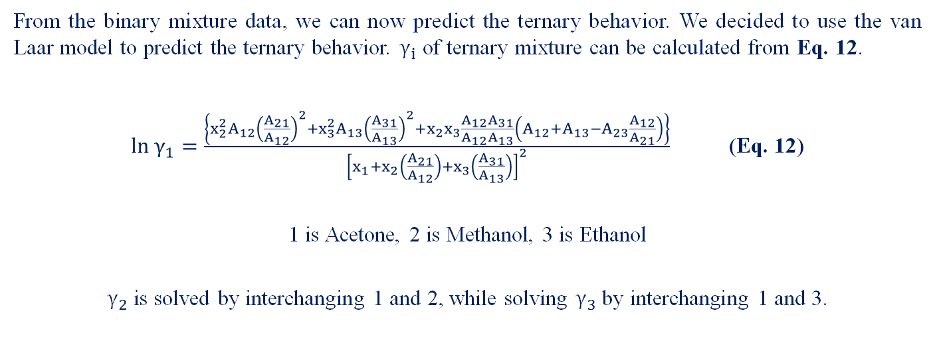
TERNARY ACTIVITY COEFFICIENTS
From the binary mixture data, we can now predict the ternary behavior. We decided to use the van Laar model to predict the ternary behavior. $γ_{i}$ of ternary mixture can be calculated from Eq. 12.
$ln γ_{1}=\frac{\left\{x_{2}^{2}A_{12}{\left(\frac{A_{21}}{A_{12}}\right)}^{2}+x_{3}^{2}A_{13}{\left(\frac{A_{31}}{A_{13}}\right)}^{2}+x_{2}x_{3}\frac{A_{12}A_{31}}{A_{12}A_{13}}\left(A_{12}+A_{13}−A_{23}\frac{A_{12}}{A_{21}}\right)\right\}}{{\left[x_{1}+x_{2}\left(\frac{A_{21}}{A_{12}}\right)+x_{3}\left(\frac{A_{31}}{A_{13}}\right)\right]}^{2}}$ (Eq. 12)
1 is Acetone, 2 is Methanol, 3 is Ethanol
$γ_{2}$ is solved by interchanging 1 and 2, while solving $γ_{3}$ by interchanging 1 and 3.

Slide 11
SAFETY

Slide 12
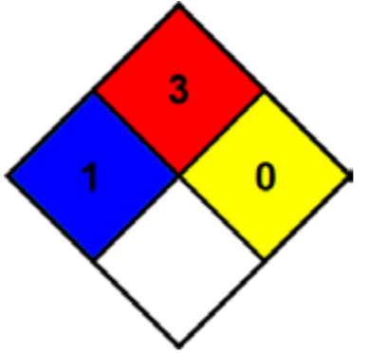
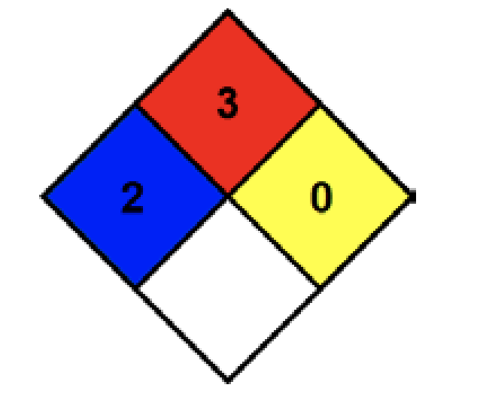
CHEMICAL HAZARDS
NFPA Diamond for Acetone (left) ¹, Methanol (middle) ², and Ethanol (right) ³
¹ Acetone; MSDS No. LC10420; LabChem: Louisville, TN, March 26, 2012.
² Methanol; MSDS No. S25426A; Fischer Scientific; Hampton NH, Jan. 8, 2015.
³ Ethanol; MSDS No. S25309; Fischer Scientific; Hampton NH, Nov. 19, 2014.

Slide 13
CHEMICAL EXPOSURE GUIDELINES
Inhalation
Splash
Ingestion
Assist exposed person to fresh air
Call UD Police
Provide CPR if needed and trained
Retrieve SDS and provide it to medical providers
Assist exposed person to safety shower/eyewash
Call UD Police
Remove all contaminated apparel
Continue safety shower/eyewash for at least 15 mins
Retrieve SDS for medical providers
Rinse mouth thoroughly
Call UD police
Do not induce vomiting
Have individual sips of water
Retrieve SDS for medical providers

Slide 14
OPERATIONAL HAZARDS AND PRECAUTIONS
Potential Hazards
Precautions
Hot equipment:
Boiler
Ignition Sources:
PID controller due to electrical wiring
Sharp Objects:
Needle on the syringe
Hot equipment:
Heating tape to insulate the boiler
Ignition Sources:
Double check wires for fraying before the experiment
Sharp Objects:
Extra precaution and wear proper PPE

Slide 15
PROCEDURE

Slide 16
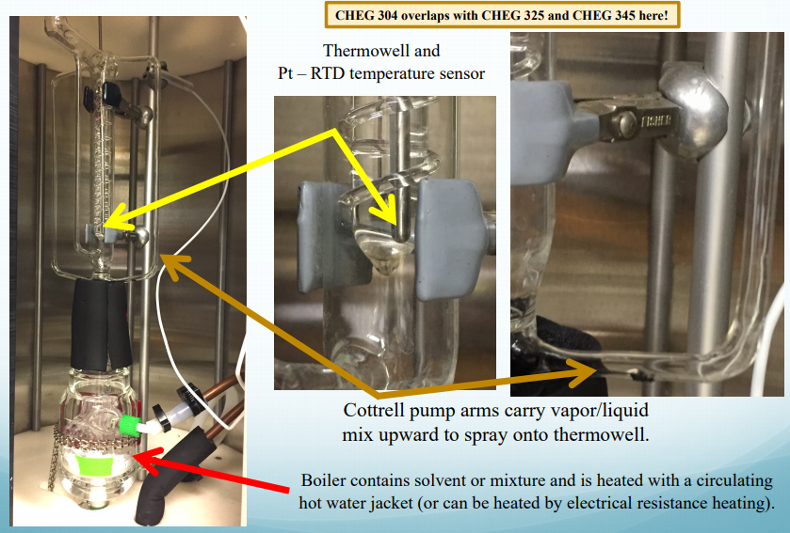
The experimental data was provided by the TAs.
This experiment was conducted using two ebulliometers allowing for 2 different sets of binary mixtures to be examined at once.
The bottom of the ebulliometer is the boiler which is wrapped in heating tape with a thermal coupler between the tape and the outer wall of the boiler allowing for the heating to be controlled by the Proportional Integral Derivative (PID) controller above.¹
The temperature is set between 40°C - 50°C higher than the anticipated boiling point, allowing for the solvent to boil and not disrupting the condenser. ¹
Buttrey, D.J. Handout. Chemical Engineering Laboratory I: CHEG 345. University of Delaware
¹ Wrenn, S.P; Lusvardi, V.S.; Whitmyre, G.; Buttrey, D.J. Vapor-Liquid Equilibria in the Undergraduate Laboratory. Chemical Engineering Education. 2000, 34(1), 74-85. (accessed March 3rd, 2021)

Slide 17
The thermal well is filled with oil to keep temperature stable and unaffected by the environment.
The Resistance Temperature Detector (RTD) sensor will then be inserted into the top of the thermal well to measure vapor phase temperature. ¹
A barometer at the top of the ebulliometer is used to track barometric pressure for error calculations in data analysis.
The solvent was extracted with a syringe and then injected into the ebulliometer at the injection point to analyze the binary mixture.
Buttrey, D.J. Handout. Chemical Engineering Laboratory I: CHEG 345. University of Delaware
¹ Wrenn, S.P; Lusvardi, V.S.; Whitmyre, G.; Buttrey, D.J. Vapor-Liquid Equilibria in the Undergraduate Laboratory. Chemical Engineering Education. 2000, 34(1), 74-85. (accessed March 3rd, 2021)

Slide 18
DATA ANALYSIS

Slide 19
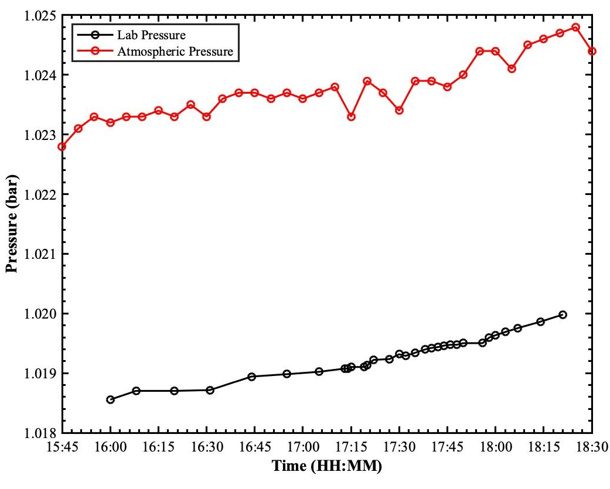
OFFSETS
Difference between lab conditions and real conditions – Systematic error
Used DEOS to obtain pressure data
Used Antoine equation with correct pressure to obtain temperature
February 25th, 2021

Slide 20
OFFSETS ANALYSIS
Mixture | Solute | Date | T_{offsets} (°C) | σ_{T,offsets}(°C) | P_{offsets} (bar) | σ_{P,offsets} (bar)
AM | A | 2/25/21 | 0.79 | 0.22 | 0.0048 | 0.0671
 | M | 2/25/21 | -0.25 | 0.02 | 0.0044 | 0.0671
ME | M | 3/5/21 | -0.11 | 0.05 | 0.0048 | 0.0671
 | E | 3/9/21 | -0.51 | 0.02 | 0.0046 | 0.0671
AE | A | 3/9/21 | 0.18 | 0.11 | 0.0044 | 0.0671
 | E | 3/8/21 | 0.07 | 0.22 | 0.0046 | 0.0671
Isobaric P is 1.027 bar
P_{offsets} are approximately constant
Methanol Injected into ethanol on March 5th injected before steady state
UNIFAC vs March 9th

Slide 21
MASS LOSS
Mixture | Solute | Actual Mass (g) | Maximum Mass (g) | Mass loss (g) | Percentage Loss (%)
AM | A | 44.368 | 45.993 | 1.625 | 3.53
 | M | 40.758 | 43.256 | 2.498 | 5.77
ME | M | 41.573 | 42.147 | 0.574 | 1.36
 | E | 41.453 | 41.881 | 0.428 | 1.02
AE | A | 41.194 | 41.247 | 0.053 | 0.13
 | E | 41.876 | 44.073 | 2.197 | 4.98
Mass loss most likely due to liquid evaporating during injection or during collection post experiment.
Highest percent loss is seen when acetone is solvent.
Notes:
expected because acetone is most volatile of components so larger difference in bp between solute and ss temp of solution in these scenarios.

Slide 22
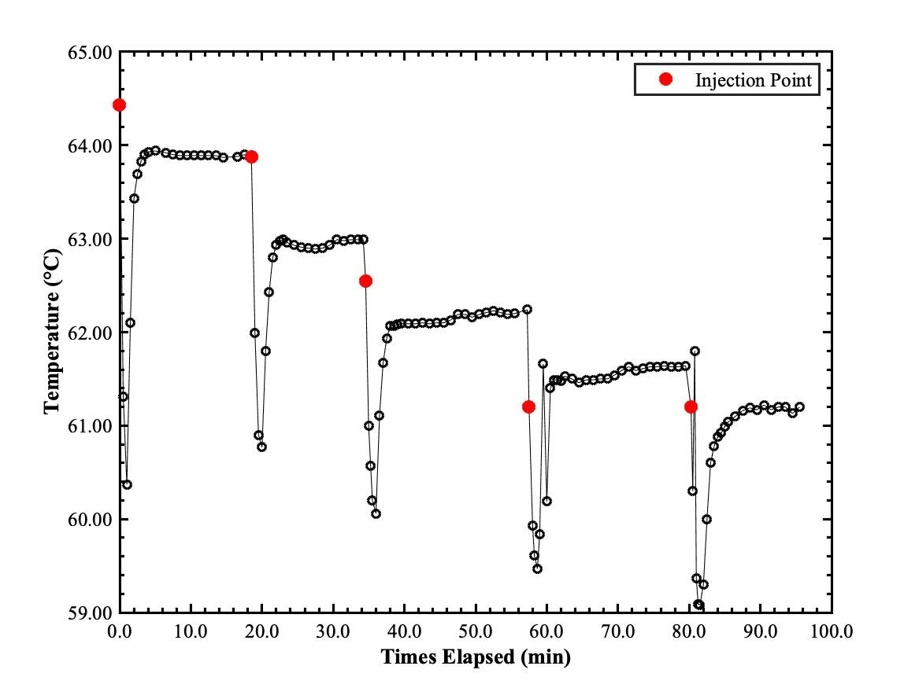
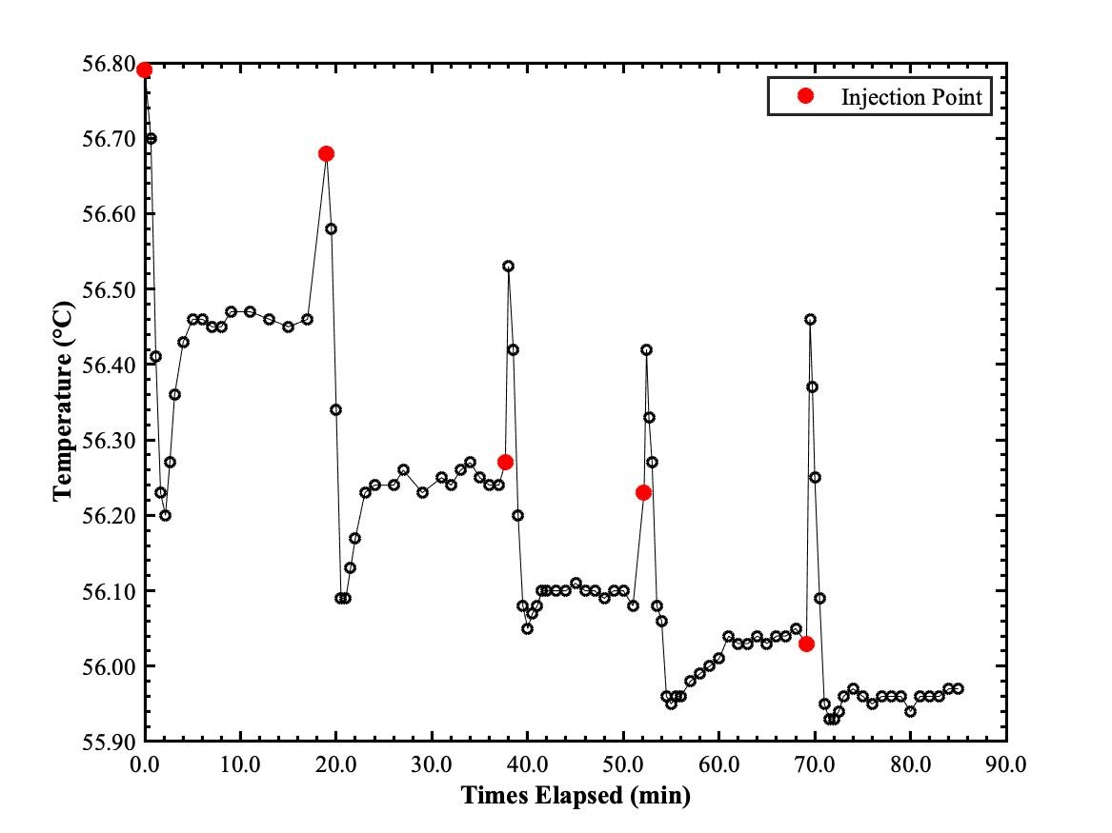
INJECTION DATA – AM ª
Acetone into Methanol
Methanol into Acetone
ª See Supplemental B for ME and AE injection data
Notes:
2 distinct trends: Left figures (a) solute with a lower bp into a solvent with higher bp. overall temp decreases rapidly as lower temp solute mixes with the higher temp solvent until mixtures steady-state temp. Right figures (b) opposite occurs, a higher bp solute is added to solvent with a lower bp. mixture's temp jumps rapidly as it accommodates hotter solute as mixing finishes, mixture temp reaches a steady-state.

Slide 23
QUADRATIC FITTING

Slide 24
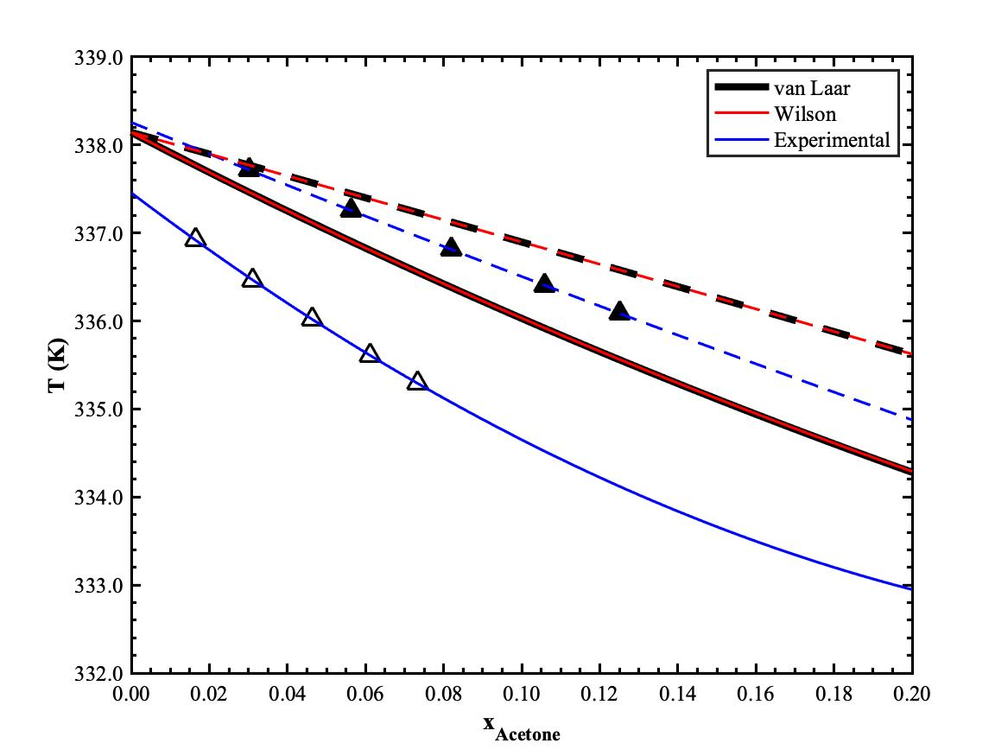
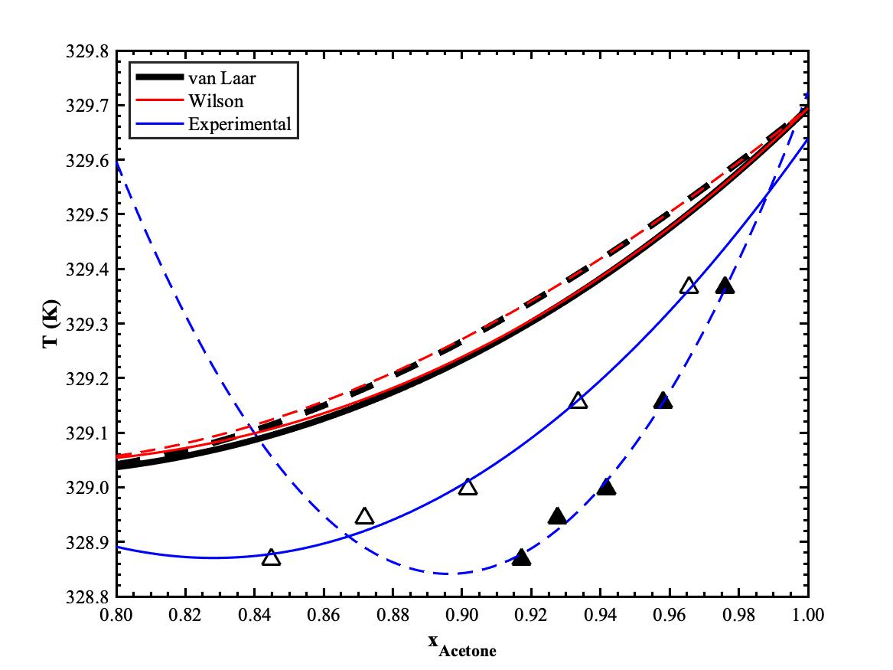
ACETONE - METHANOL
△ - x_{A},▲ - y_{A}
━ x, --- y
$$T_{x}=337.46−33.57x_{A}+55.15x_{A}^{2}$$
$$T_{x}=346.70−43.07x_{A}+26.00x_{A}^{2}$$

Slide 25
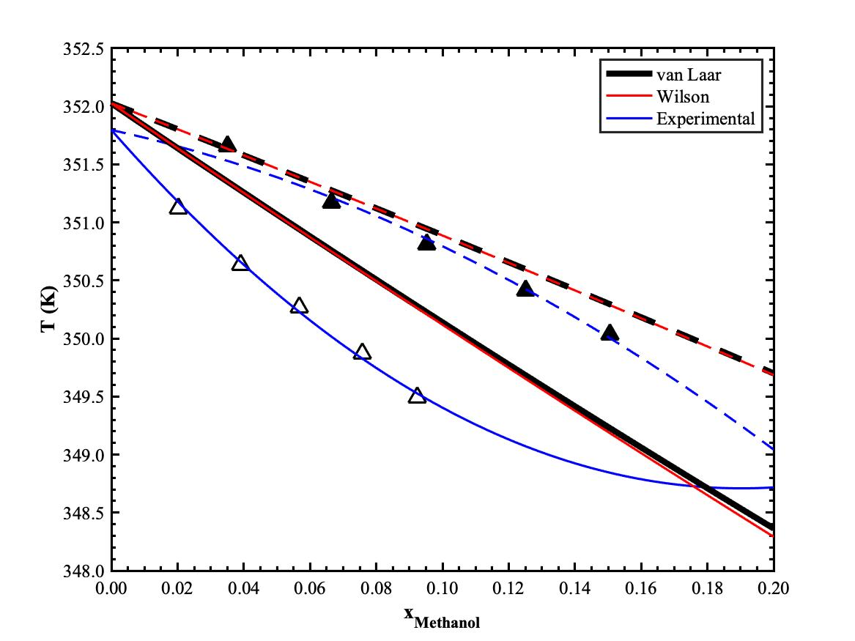
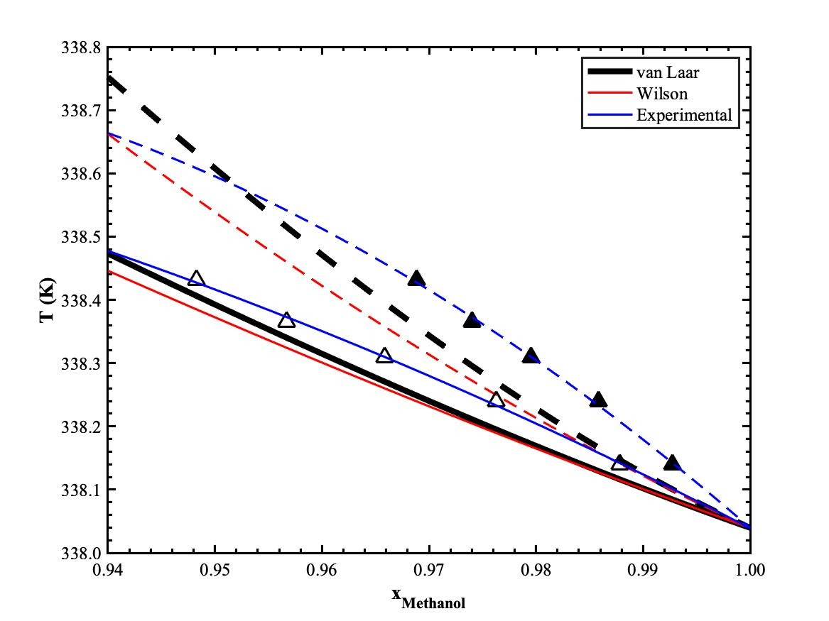
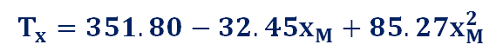
METHANOL - ETHANOL
△ - x_{M},▲ - y_{M}
━ x, --- y
$$T_{x}=351.80−32.45x_{M}+85.27x_{M}^{2}$$
$$T_{x}=322.65+39.54x_{M}−24.15x_{M}^{2}$$

Slide 26
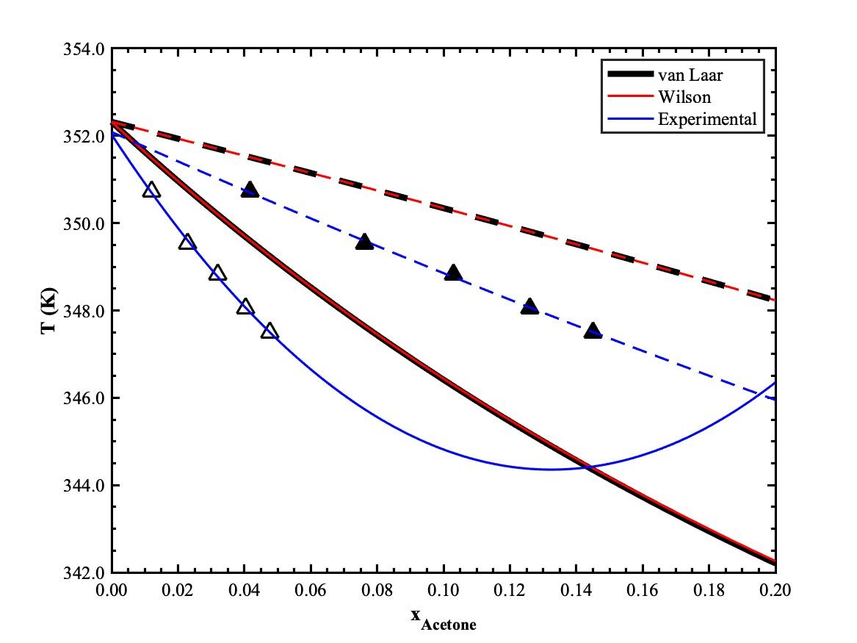
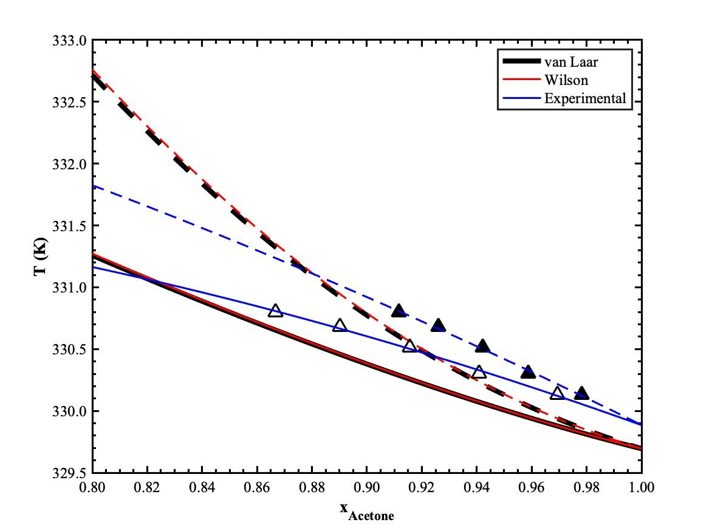
ACETONE - ETHANOL
△ - x_{A},▲ - y_{A}
━ x, --- y
$$T_{x}=352.03−115.88x_{A}+437.50x_{A}^{2}$$
$$T_{x}=329.97+7.80x_{A}−7.89x_{A}^{2}$$

Slide 27
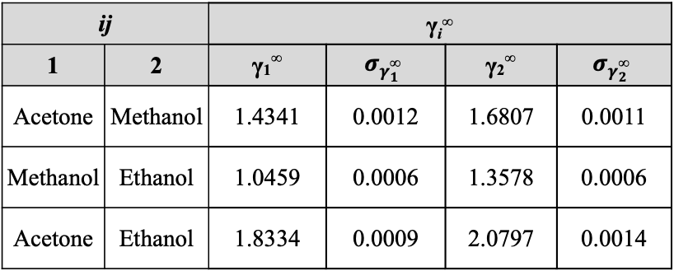
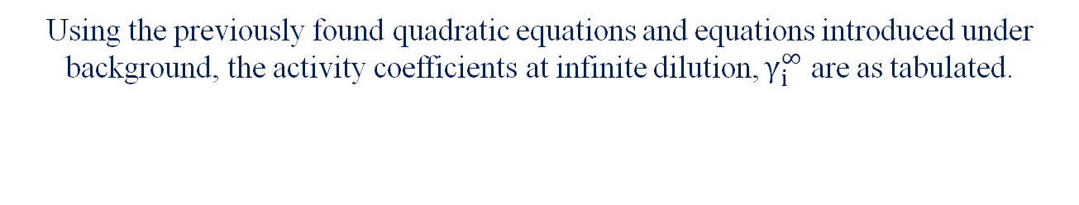
INFINITE DILUTION
Using the previously found quadratic equations and equations introduced under background, the activity coefficients at infinite dilution, $γ_{i}^{∞}$ are as tabulated.
ij |  | γ_{i}∞
1 | 2 | γ₁∞ | $$σ_{γ_{1}^{\text{∞}}}$$ | γ₂∞ | $$σ_{γ_{2}^{\text{∞}}}$$
Acetone | Methanol | 1.4341 | 0.0012 | 1.6807 | 0.0011
Methanol | Ethanol | 1.0459 | 0.0006 | 1.3578 | 0.0006
Acetone | Ethanol | 1.8334 | 0.0009 | 2.0797 | 0.0014

Slide 28
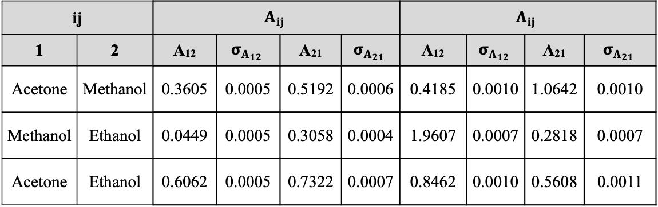
MODEL PARAMETERS
ij |  | $$A_{ij}$$ |  |  |  | $$Λ_{ij}$$
1 | 2 | A₁₂ | $$σ_{A_{12}}$$ | A₂₁ | $$σ_{A_{21}}$$ | Λ₁₂ | $$σ_{Λ_{12}}$$ | Λ₂₁ | $$σ_{Λ_{21}}$$
Acetone | Methanol | 0.3605 | 0.0005 | 0.5192 | 0.0006 | 0.4185 | 0.0010 | 1.0642 | 0.0010
Methanol | Ethanol | 0.0449 | 0.0005 | 0.3058 | 0.0004 | 1.9607 | 0.0007 | 0.2818 | 0.0007
Acetone | Ethanol | 0.6062 | 0.0005 | 0.7322 | 0.0007 | 0.8462 | 0.0010 | 0.5608 | 0.0011

Slide 29
BINARY MIXTURES

Slide 30
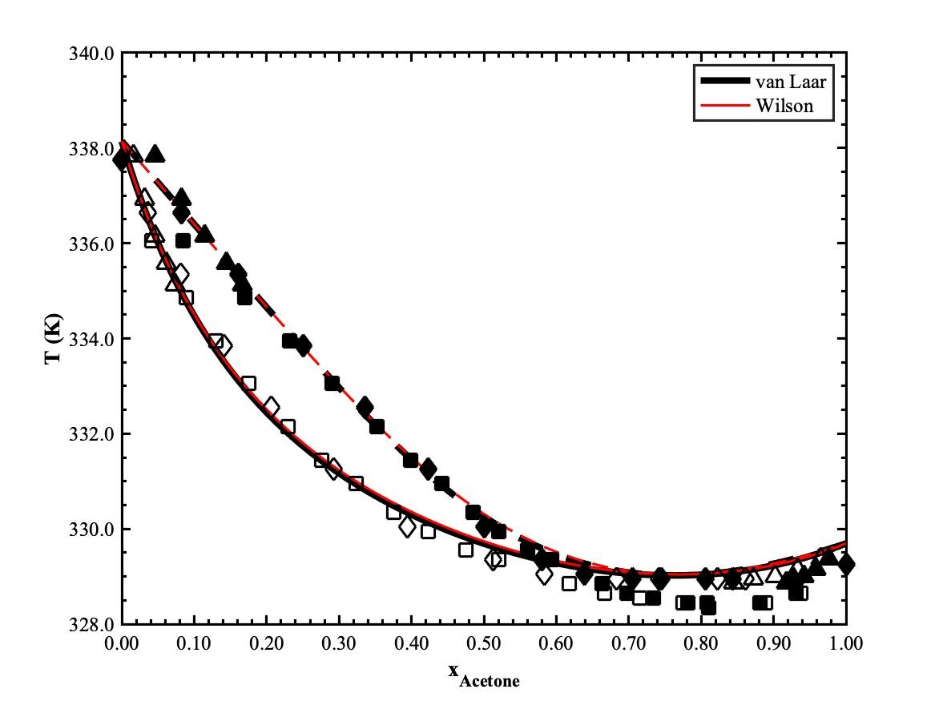
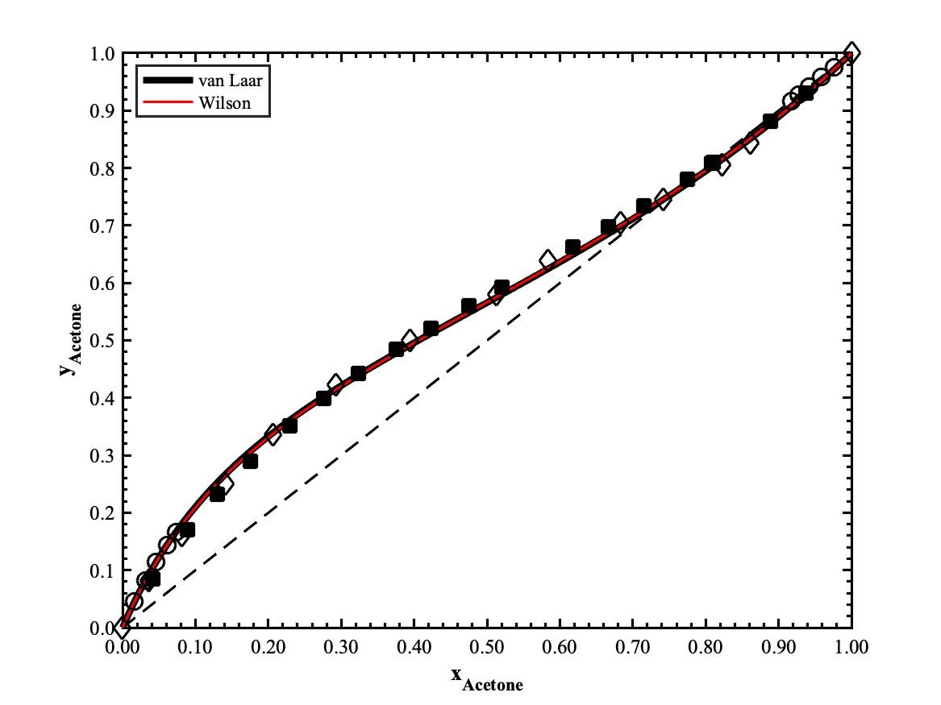
Acetone – Methanol Binary Mixture
□ ¹ - x_{A}, ■ ¹ - y_{A} at P = 1.013 bar ◊ ² - x_{A}, ◆ ² - y_{A} at P = 1.013 bar
Experimental data (△ - x_{A},▲ - y_{A} at P = 1.0271 bar, ━ x_{A}, --- y_{A})
■ ¹ at P = 1.013 bar ◊ ² at P = 1.013 bar
Experimental data (○ at P = 1.0271 bar)
¹ Tu, C.-H., Wu, Y.-S., & Liu, T.-L. Vapor-liquid equilibria of the binary systems formed by methanol, acetone and methyl vinyl ketone at 100.0 ± 0.2 kPa. Fluid Phase Equilibria 1997, 129(1-2), 129–137. doi:10.1016/s0378-3812(96)03183-4 (accessed March 15th, 2021) ² Amer, H. H., Paxton, R. R., & Winkle, M. V. Methanol-Ethanol-Acetone. Industrial & Engineering Chemistry 1956, 48(1), 142-146. doi: 10.1021/ie50553a41 (accessed March 15th, 2021)

Slide 31
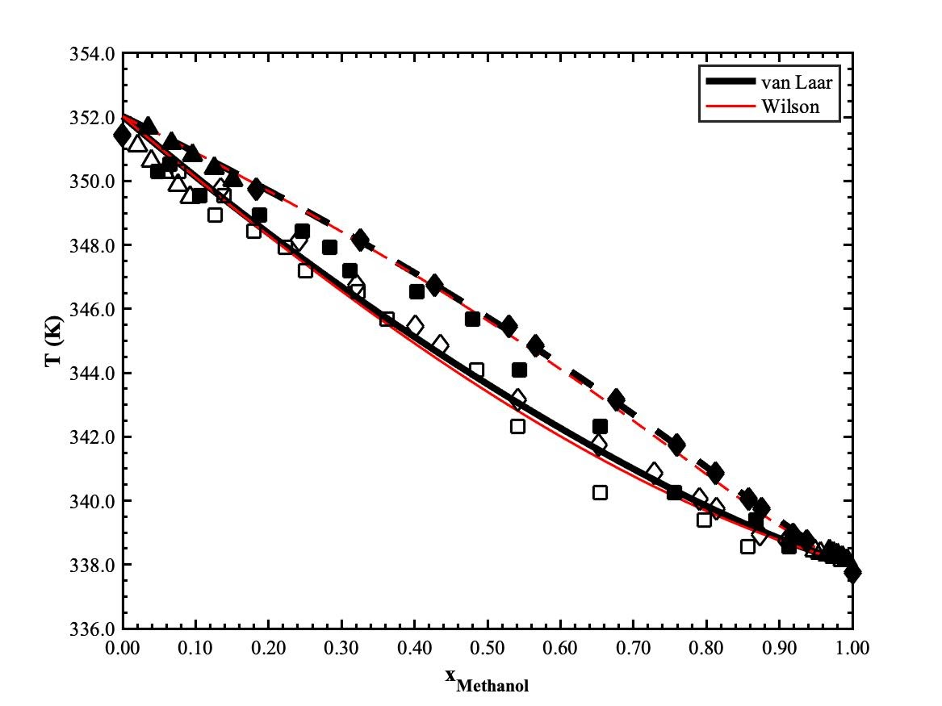
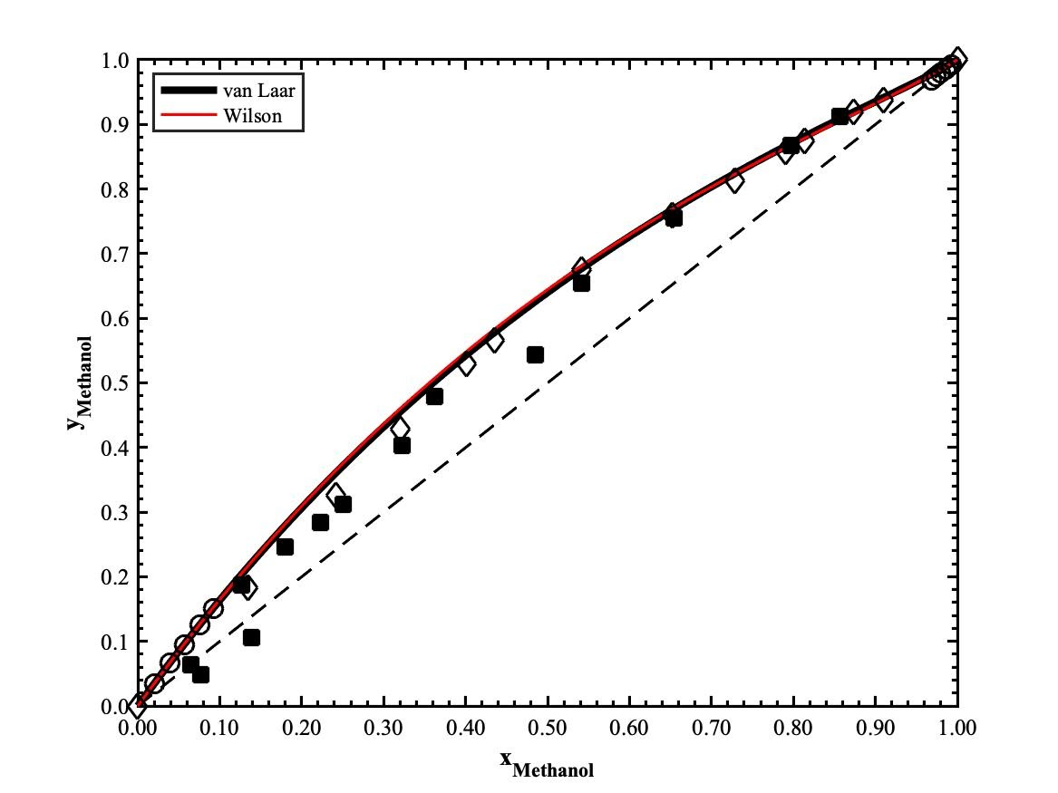
Methanol – Ethanol Binary Mixture
□ ¹ - x_{M}, ■ ¹ - y_{M} at P = 1.013 bar ◊ ² - x_{M}, ◆ ² - y_{M} at P = 1.013 bar
Experimental data (△ - x_{M},▲ - y_{M} at P = 1.0271 bar, ━ x_{M}, --- y_{M}).
■ ¹ at P = 1.013 bar ◊ ³ at P = 1.013 bar
Experimental data (○ at P = 1.0271 bar)
¹ Ilia, A. Vapor-Liquid Equilibrium Measurements in Binary Polar Systems. Diploma Thesis, Vienna University of Technology, Vienna, 2016. (accessed March 16th, 2021)
² Amer, H. H., Paxton, R. R., & Winkle, M. V. Methanol-Ethanol-Acetone. Industrial & Engineering Chemistry 1956, 48(1), 142-146. doi: 10.1021/ie50553a41 (accessed March 15th, 2021) ³ Tu, C.-H., Wu, Y.-S., & Liu, T.-L. Vapor-liquid equilibria of the binary systems formed by methanol, acetone and methyl vinyl ketone at 100.0 ± 0.2 kPa. Fluid Phase Equilibria 1997, 129(1-2), 129–137. doi:10.1016/s0378-3812(96)03183-4 (accessed March 15th, 2021)

Slide 32
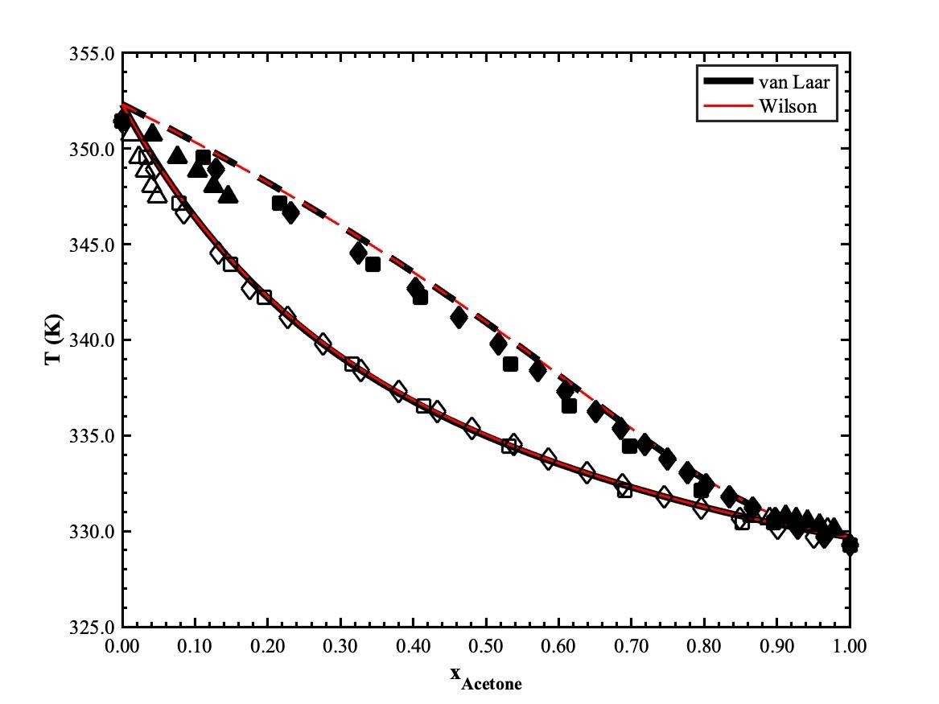
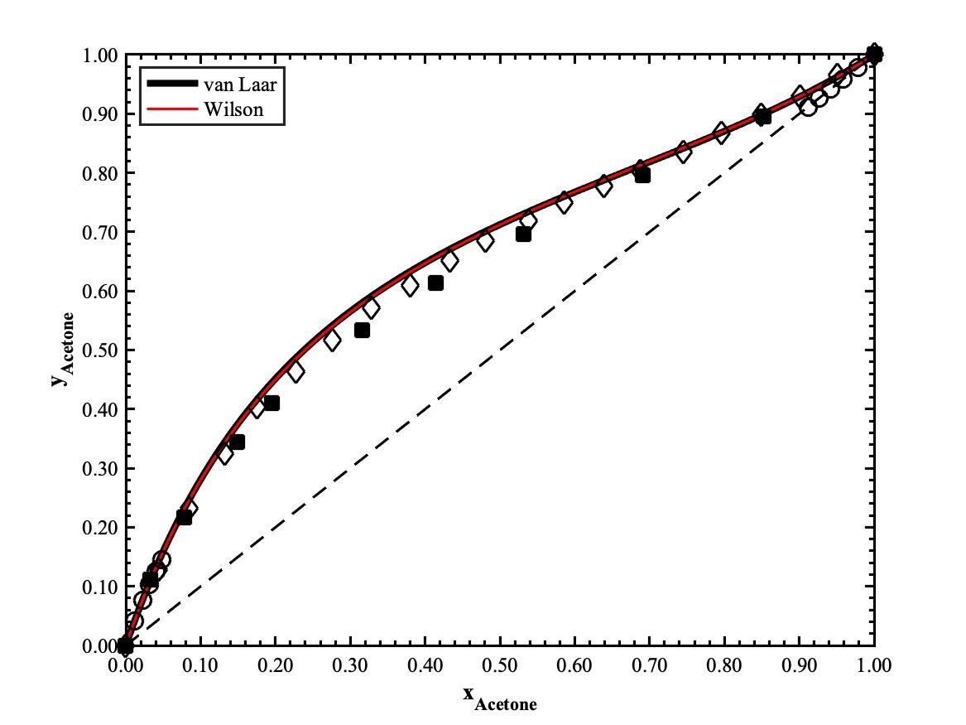
Acetone – Ethanol Binary Mixture
(□ ¹ - x_{A}, ■ ¹ - y_{A} at P = 1.013 bar ◊ ² - x_{A}, ◆ ² - y_{A} at P = 1.013 bar
Experimental data (△ - x_{A},▲ - y_{A} at P = 1.0271 bar, ━ x_{A}, --- y_{A})
■ ¹ at P = 1.013 bar ◊ ² at P = 1.013 bar)
Experimental data (○ at P = 1.0271 bar)
¹ Amer, H. H., Paxton, R. R., & Winkle, M. V. Methanol-Ethanol-Acetone. Industrial & Engineering Chemistry 1956, 48(1), 142-146. doi: 10.1021/ie50553a41 (accessed March 15th, 2021)
² Ku, H.-C., & Tu, C.-H. (2005). Isobaric vapor–liquid equilibria for mixtures of acetone, ethanol, and 2,2,4-trimethylpentane at 101.3kPa. Fluid phase Equilibria 2005, 231(1), 99-108. doi: 10.1016/j.fluid.2005.01.007 (accessed March 15th, 2021)

Slide 33
TERNARY MIXTURES

Slide 34
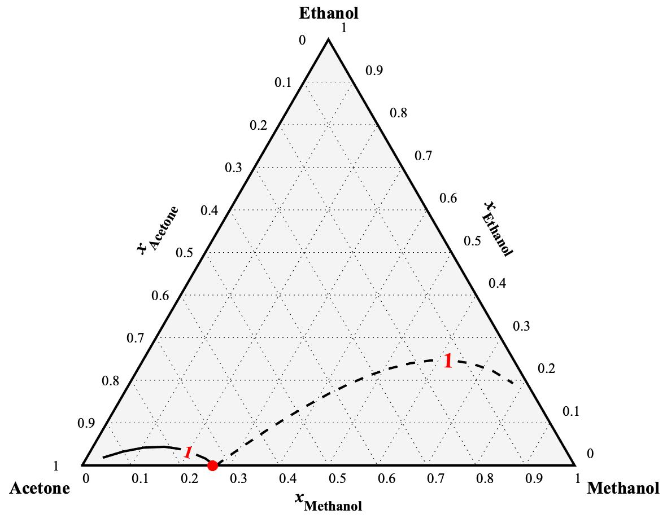
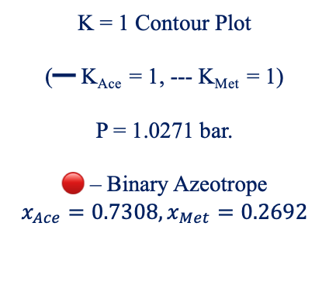
K FACTOR TERNARY DIAGRAM ª
K = 1 Contour Plot
(━ K_{Ace} = 1, --- K_{Met} = 1)
P = 1.0271 bar.
🔴 – Binary Azeotrope
$$x_{Ace}=0.7308,x_{Met}=0.2692$$
ª See Supplemental C for K contour at various K factors

Slide 35
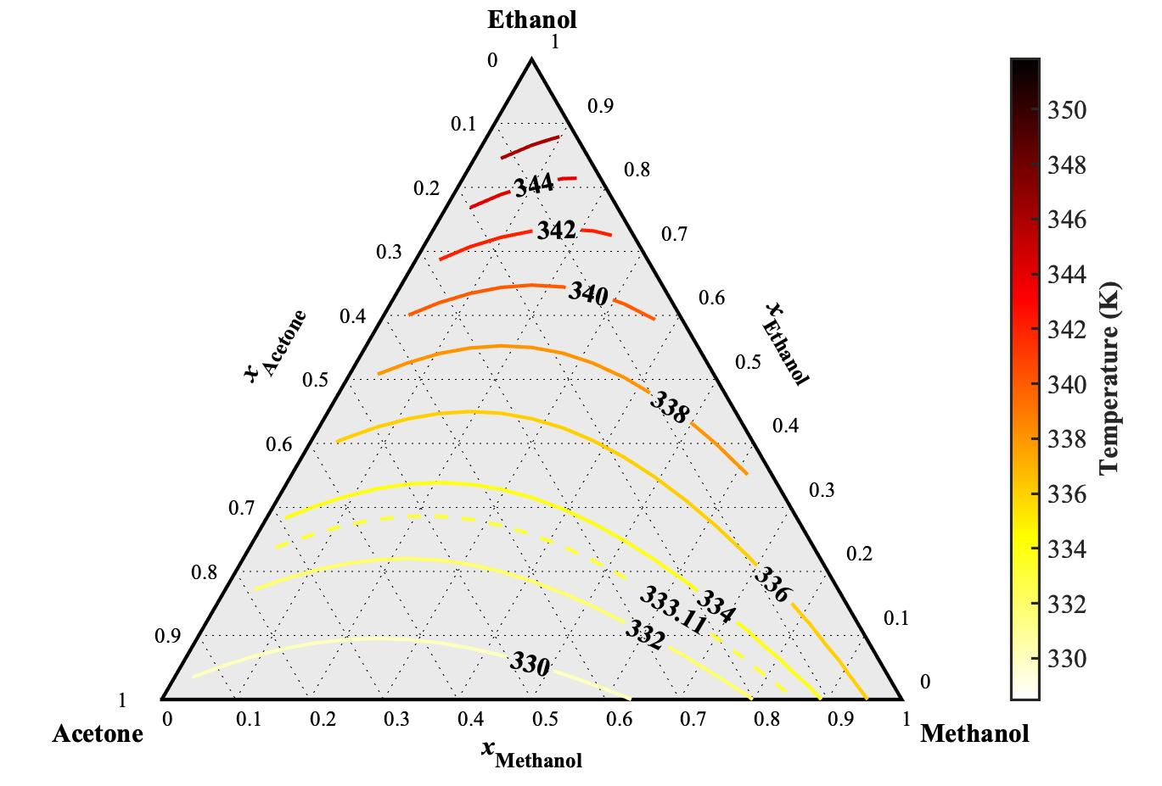
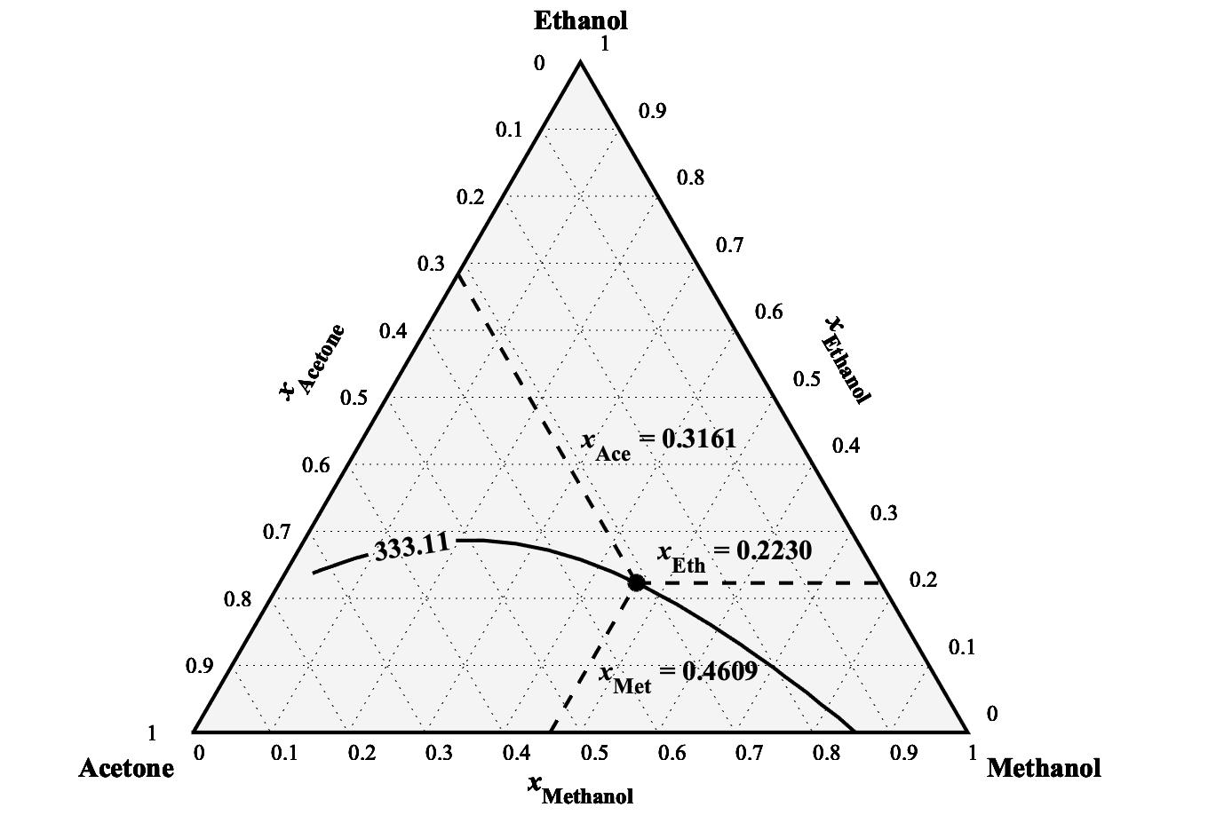
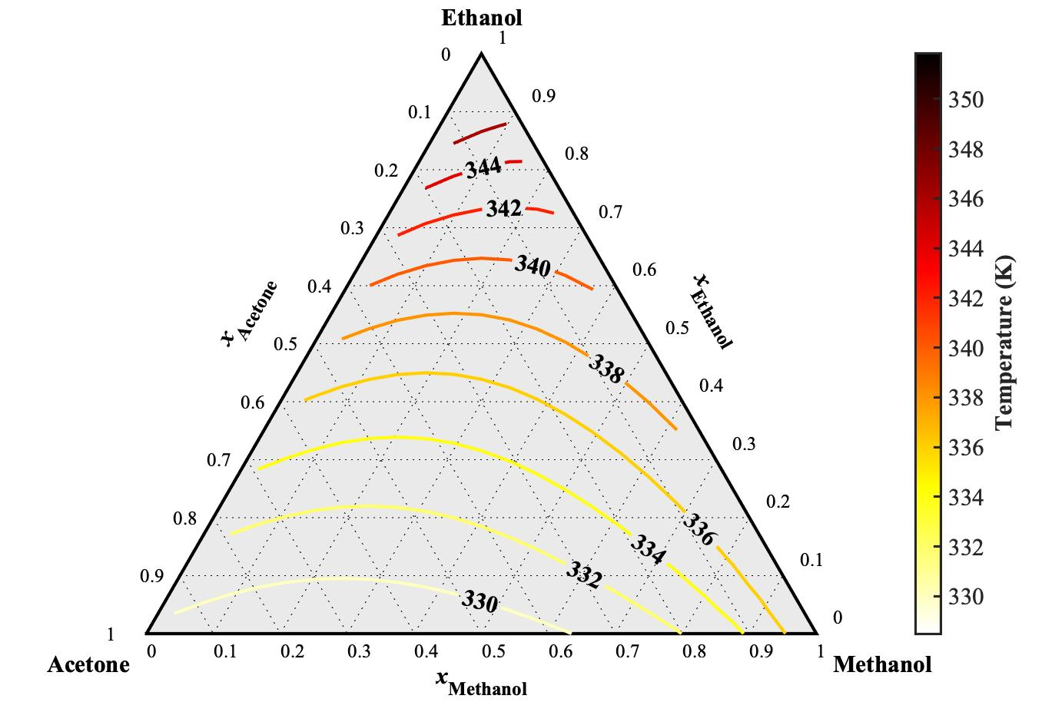
TEMPERATURE TERNARY DIAGRAM
P = 1.0271 bar

Slide 36
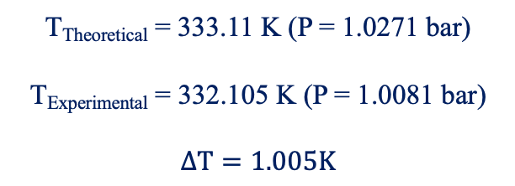
TEMPERATURE TERNARY DIAGRAM
T_{Theoretical} = 333.11 K (P = 1.0271 bar)
T_{Experimental} = 332.105 K (P = 1.0081 bar)
$$ΔT=1.005K$$

Slide 37
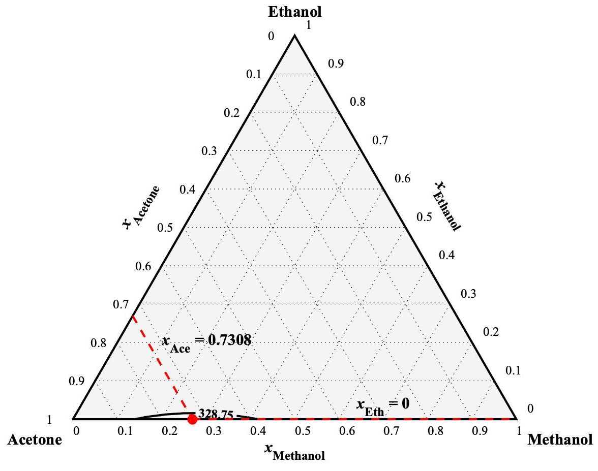
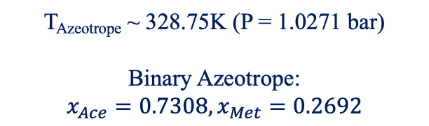
TEMPERATURE TERNARY DIAGRAM At AZEOTROPE
T_{Azeotrope} ~ 328.75K (P = 1.0271 bar)
Binary Azeotrope:
$$x_{Ace}=0.7308,x_{Met}=0.2692$$

Slide 38
CONCLUSION & RECOMENDATIONS

Slide 39
CONCLUSIONS
Acetone offers significant difficulty in separation
Far from ideality due to strong intermolecular interactions
Ethanol offers best separation properties due it not having any azeotropic tendencies
Very little intersection with other components
Methanol has relatively good properties for separation but would have problems in this mixture due to it interactions with acetone

Slide 40
RECOMENDATIONS
Experimental data collected on same day
Offsets and pressure would be the same
Experiments with higher percentage mass loss could be rerun for higher accuracy in mass calculations
Model selection done with more mathematical method vs. visual analysis

Slide 41
REFERENCES
Acetone; MSDS No. LC10420; LabChem: Louisville, TN, March 26, 2012.
Methanol; MSDS No. S25426A; Fischer Scientific; Hampton NH, Jan. 8, 2015.
Ethanol; MSDS No. S25309; Fischer Scientific; Hampton NH, Nov. 19, 2014.
Wrenn, S.P; Lusvardi, V.S.; Whitmyre, G.; Buttrey, D.J. Vapor-Liquid Equilibria in the Undergraduate Laboratory. Chemical Engineering Education. 2000, 34(1), 74-85. (accessed March 3rd, 2021)
Buttrey, D.J. Handout. Chemical Engineering Laboratory I: CHEG 345. University of Delaware
Tu, C.-H., Wu, Y.-S., & Liu, T.-L. Vapor-liquid equilibria of the binary systems formed by methanol, acetone and methyl vinyl ketone at 100.0 ± 0.2 kPa. Fluid Phase Equilibria 1997, 129(1-2), 129–137. doi:10.1016/s0378-3812(96)03183-4 (accessed March 15th, 2021)
Amer, H. H., Paxton, R. R., & Winkle, M. V. Methanol-Ethanol-Acetone. Industrial & Engineering Chemistry 1956, 48(1), 142-146. doi: 10.1021/ie50553a41 (accessed March 15th, 2021)
Ilia, A. Vapor-Liquid Equilibrium Measurements in Binary Polar Systems. Diploma Thesis, Vienna University of Technology, Vienna, 2016. (accessed March 16th, 2021)
Ku, H.-C., & Tu, C.-H. (2005). Isobaric vapor–liquid equilibria for mixtures of acetone, ethanol, and 2,2,4-trimethylpentane at 101.3kPa. Fluid phase Equilibria 2005, 231(1), 99-108. doi: 10.1016/j.fluid.2005.01.007 (accessed March 15th, 2021)
NIST Office of Data and Informatics. NIST Chemistry WebBook, SRD 69. https://webbook.nist.gov/ (accessed Feb 25, 2021).

Slide 42
THANK YOU

Slide 43
SUPPLEMENTAL SLIDES

Slide 44
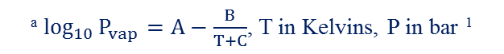
SUPPLEMENTAL A: Antoine Parameters
Compound | Temperature | Antoine Equation Parameters ª
 | Range (K) | A | B | C
Acetone | 259.16 - 507.60 | 4.42448 | 1312.253 | -32.445
Methanol | 288.10 - 356.83 | 5.20409 | 1581.341 | -33.500
Ethanol | 292.77 - 366.63 | 5.24677 | 1598.673 | -46.424
ª $\log_{10}{P_{vap}}=A−\frac{B}{T+C}$, T in Kelvins, P in bar ¹
¹ NIST Office of Data and Informatics. NIST Chemistry WebBook, SRD 69. https://webbook.nist.gov/ (accessed Feb 25, 2021).

Slide 45
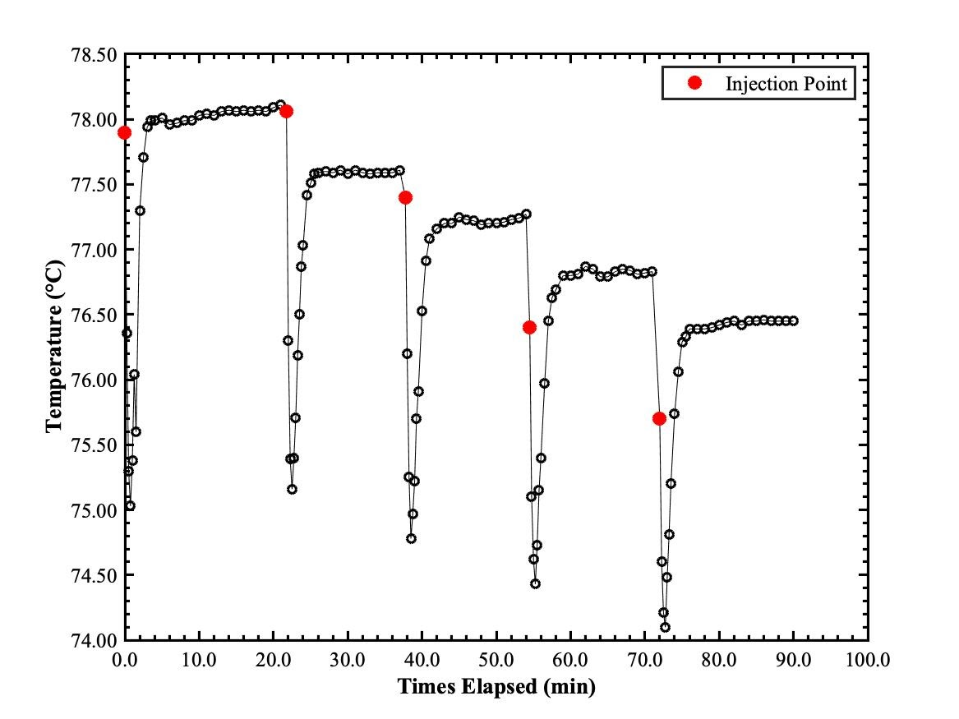
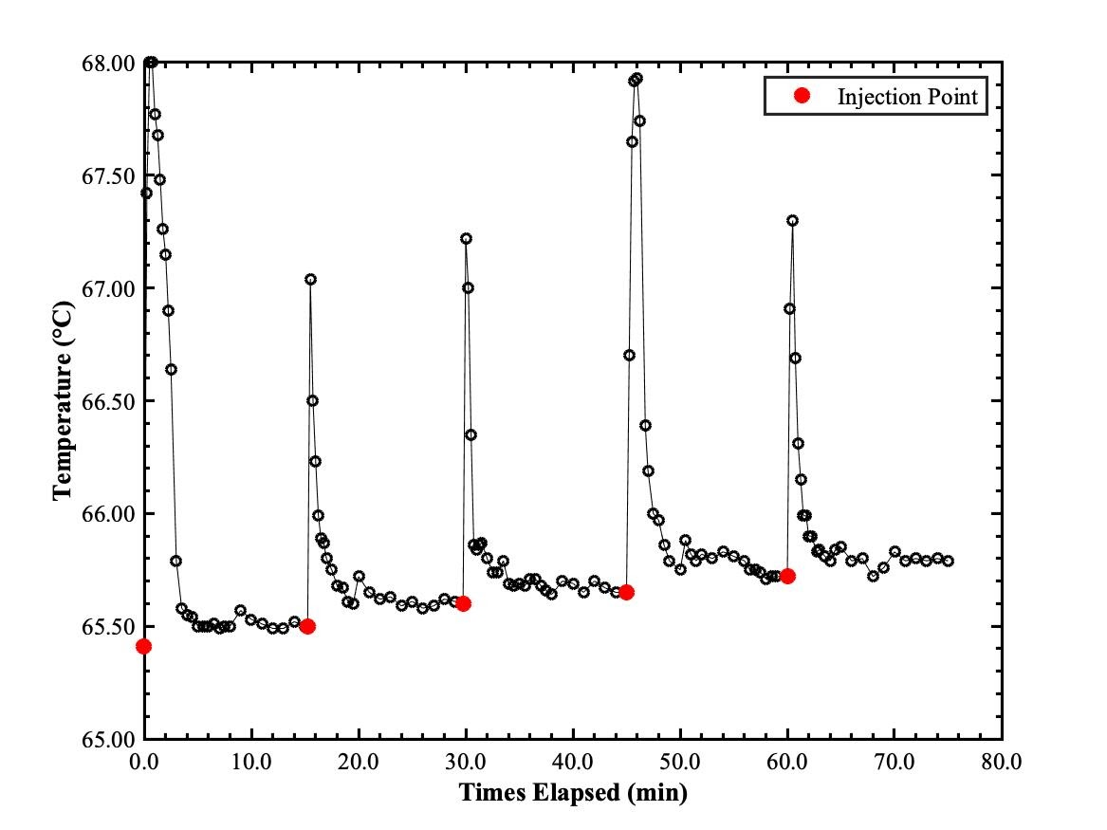
SUPPLEMENTAL B: Injection Data - ME
Methanol into Ethanol
Ethanol into Methanol

Slide 46
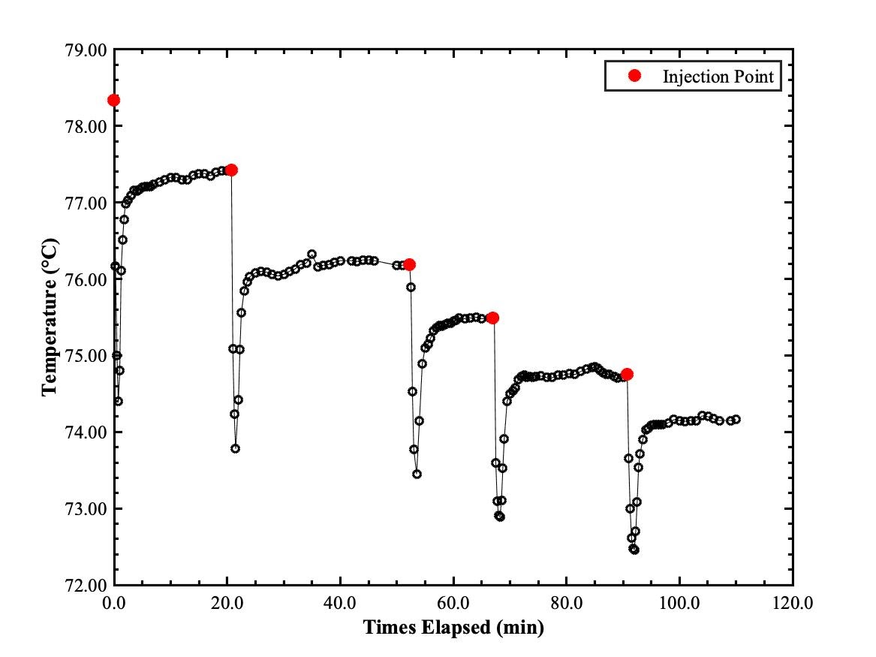
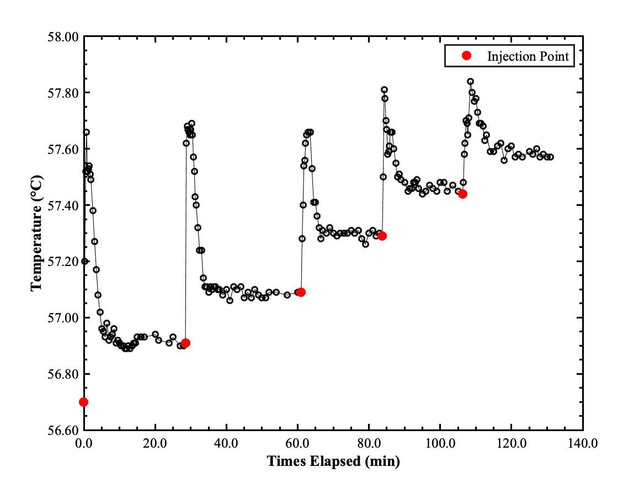
SUPPLEMENTAL B: Injection Data - AE
Acetone into Ethanol
Ethanol into Acetone

Slide 47
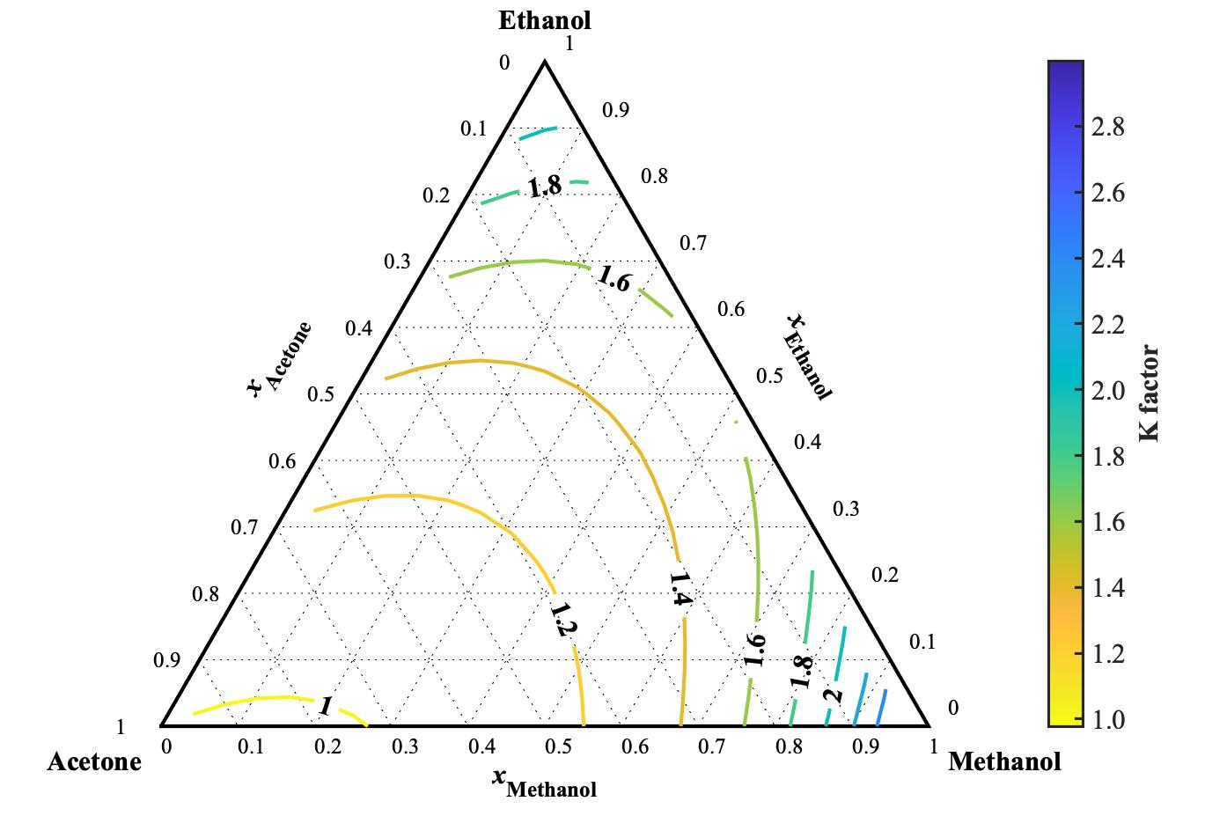
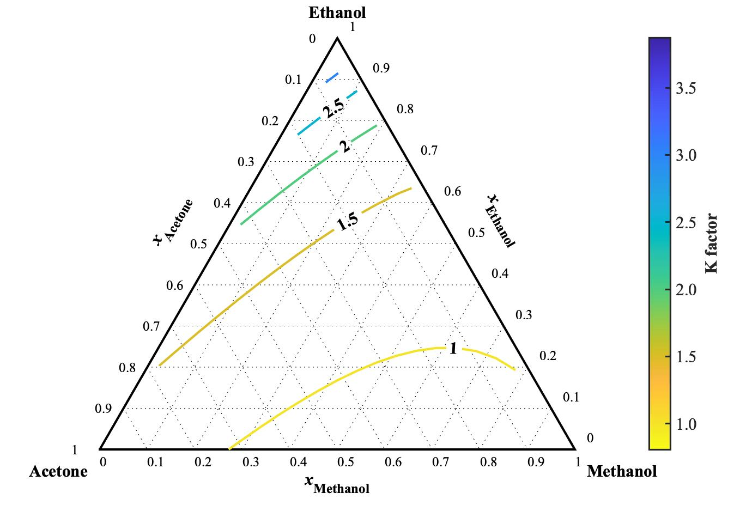
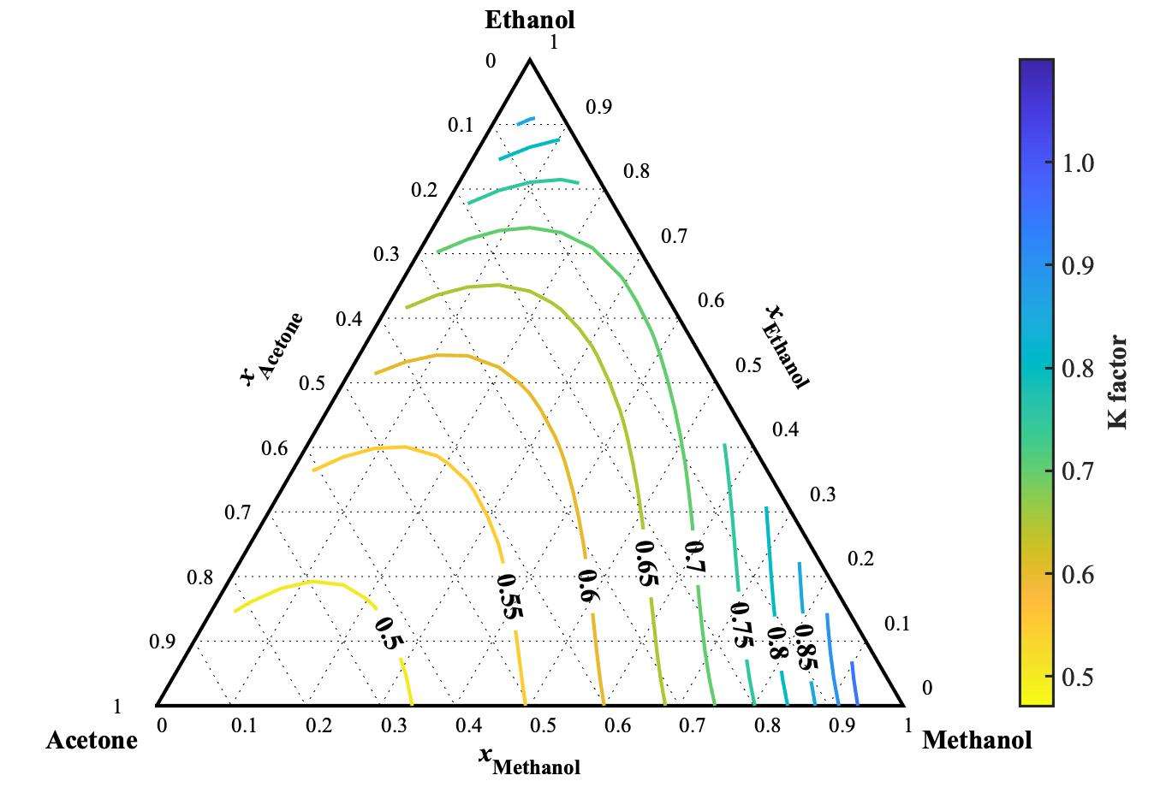

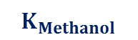
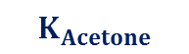
SUPPLEMENTAL C: K Factor Various Contours
$$K_{Acetone}$$
$$K_{Methanol}$$
$$K_{Ethanol}$$

